Slide 1

Are you ready to join the ultimate battle ?

Slide 2
Then get ready soldier…

Slide 3


Slide 4
The Welcome-Screen

Slide 5
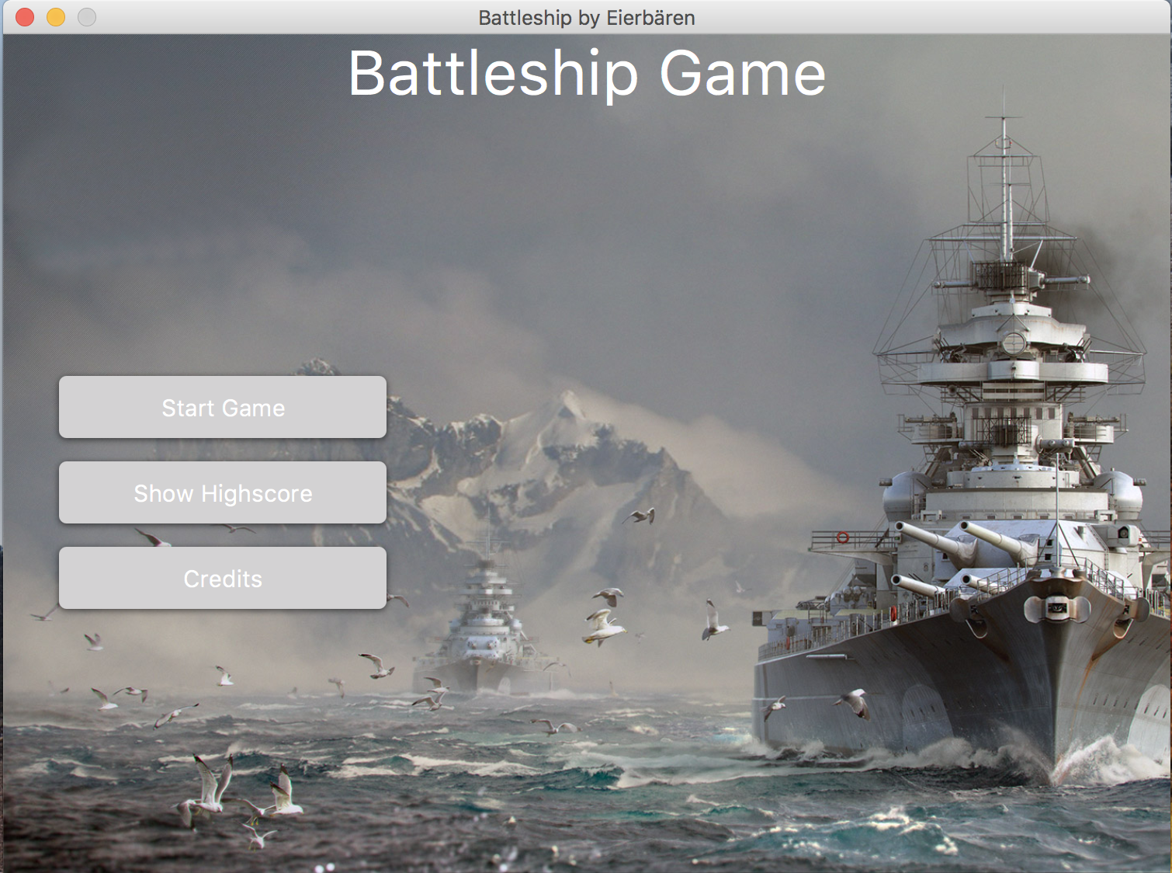

Slide 6
The Game-Screen

Slide 7
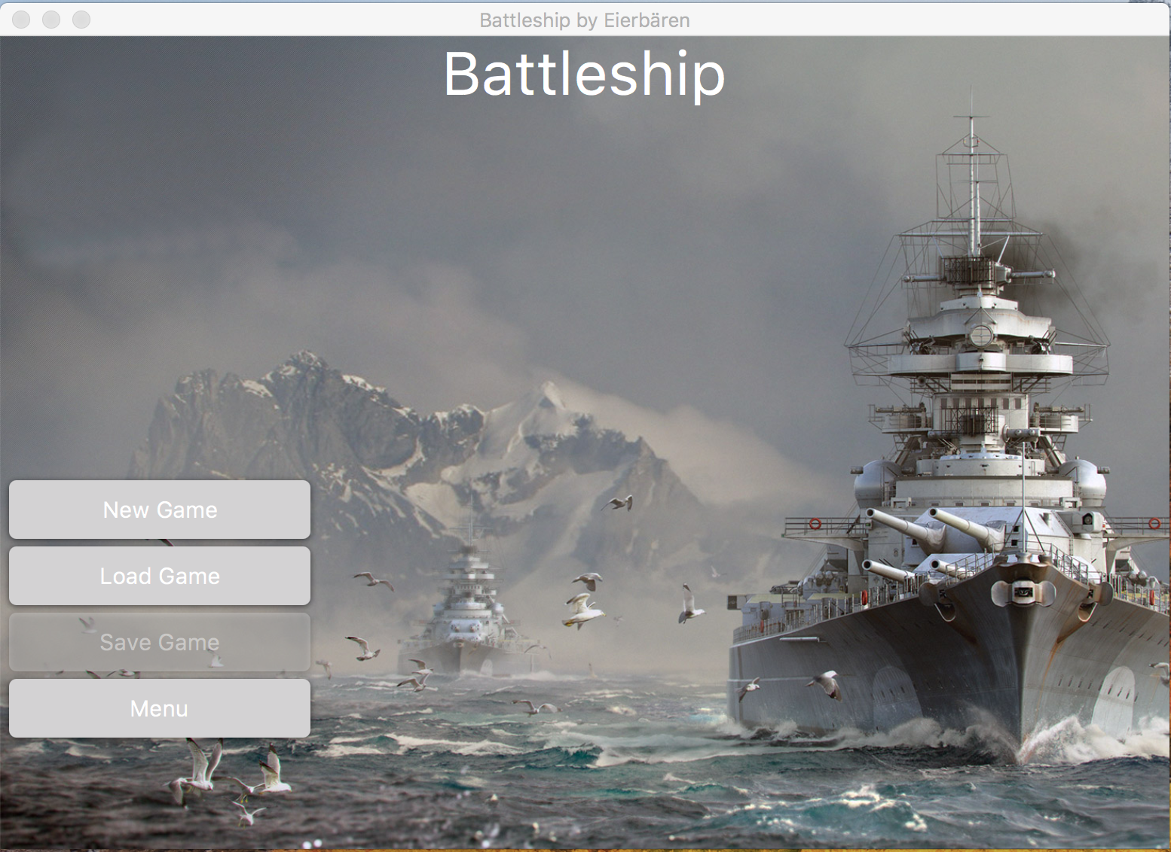

Slide 8
The Edit-Screen

Slide 9
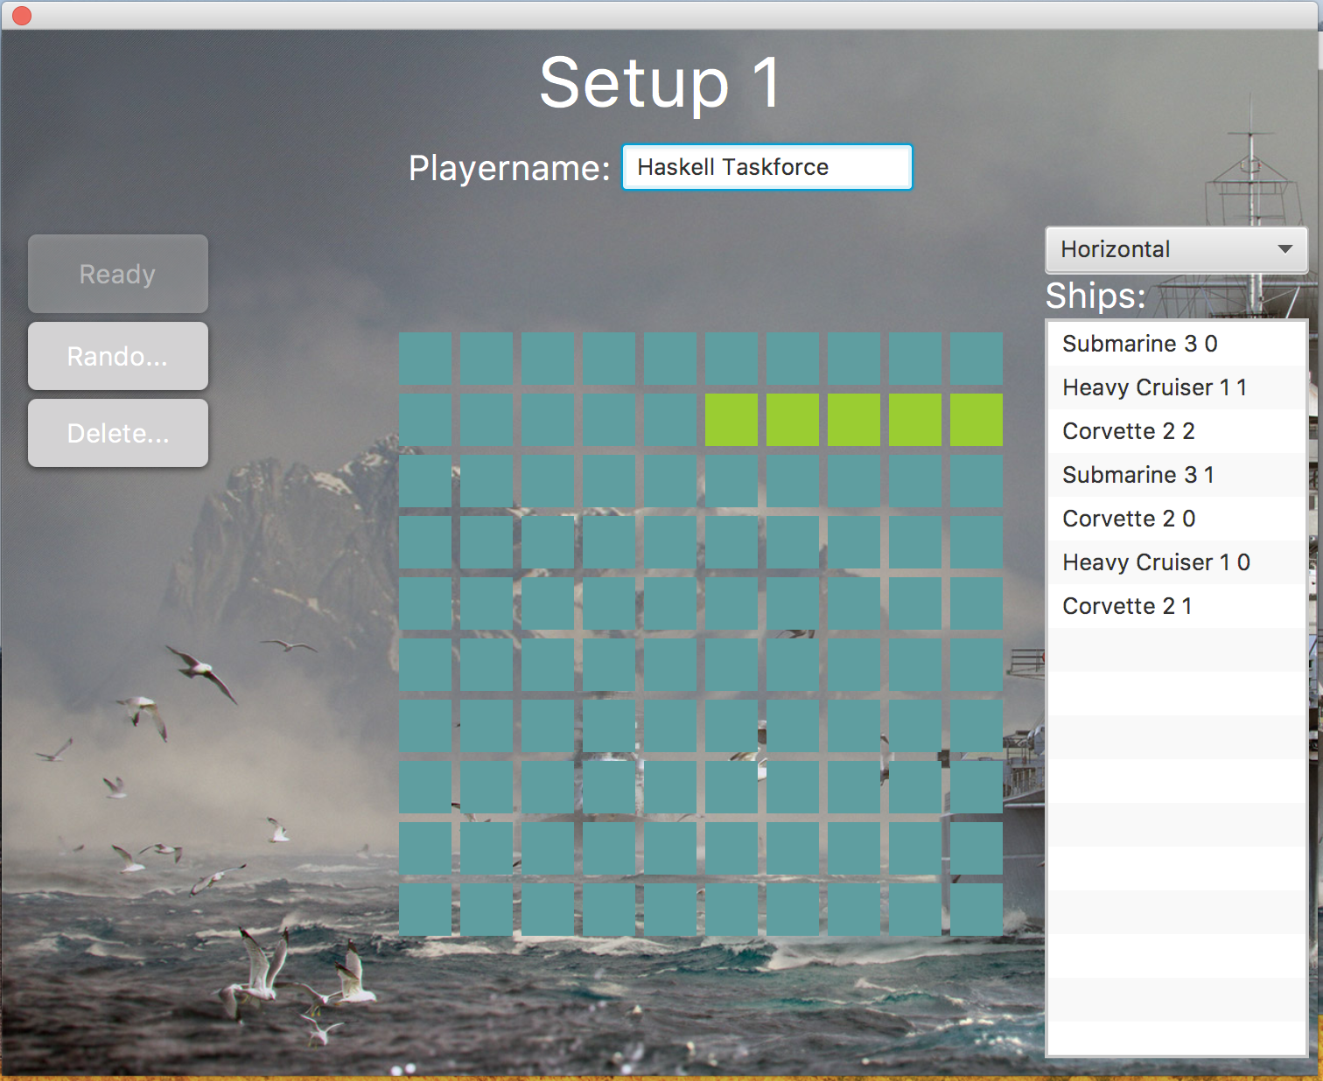

Slide 10
The Battle-Screen

Slide 11
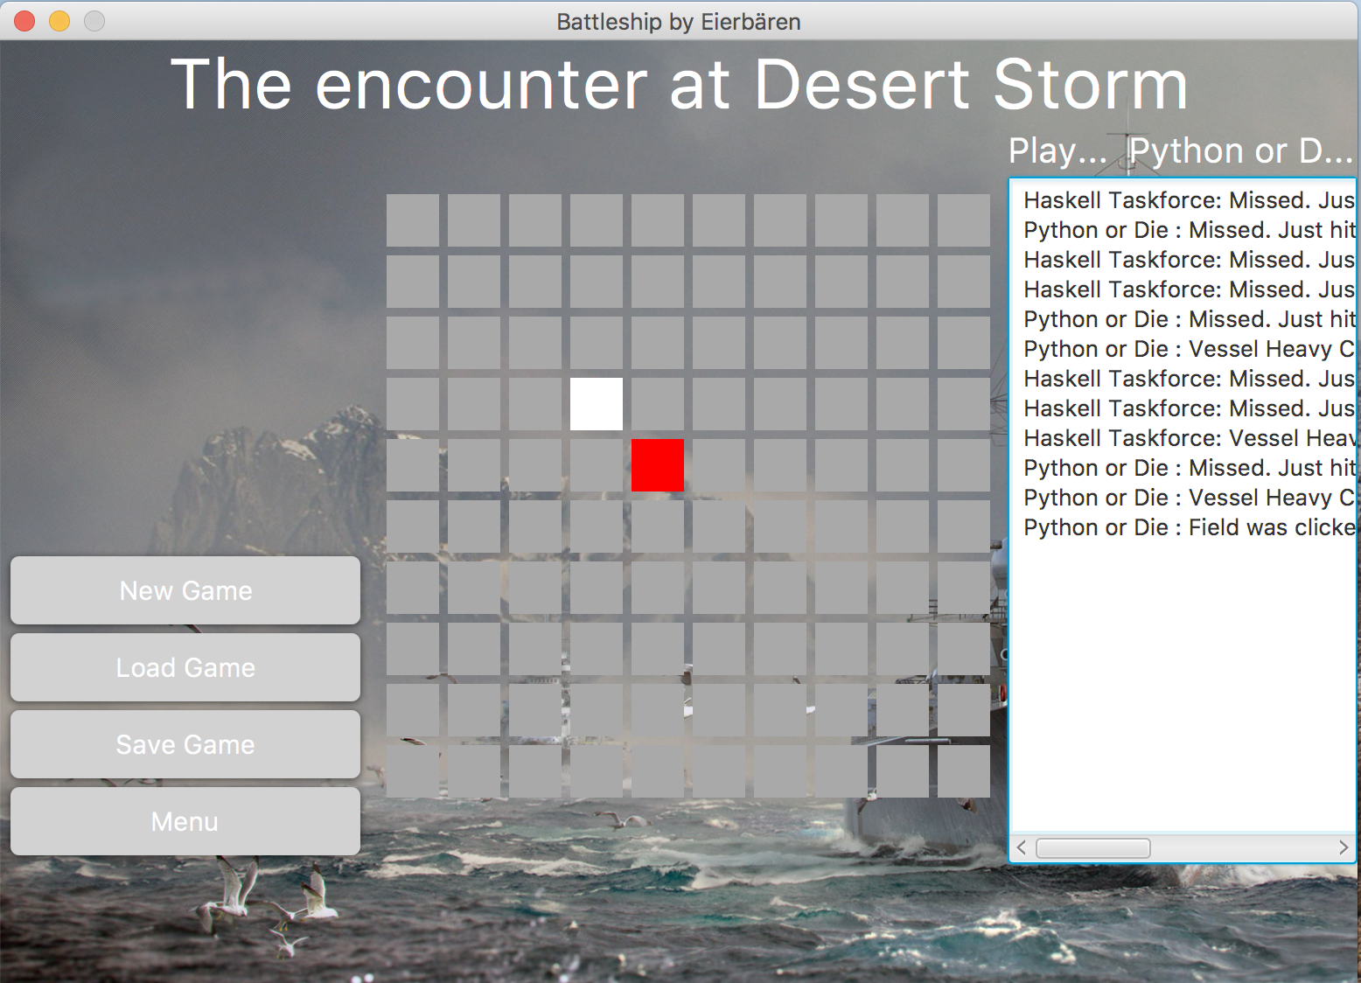

Slide 12
The Highscore-Screen

Slide 13
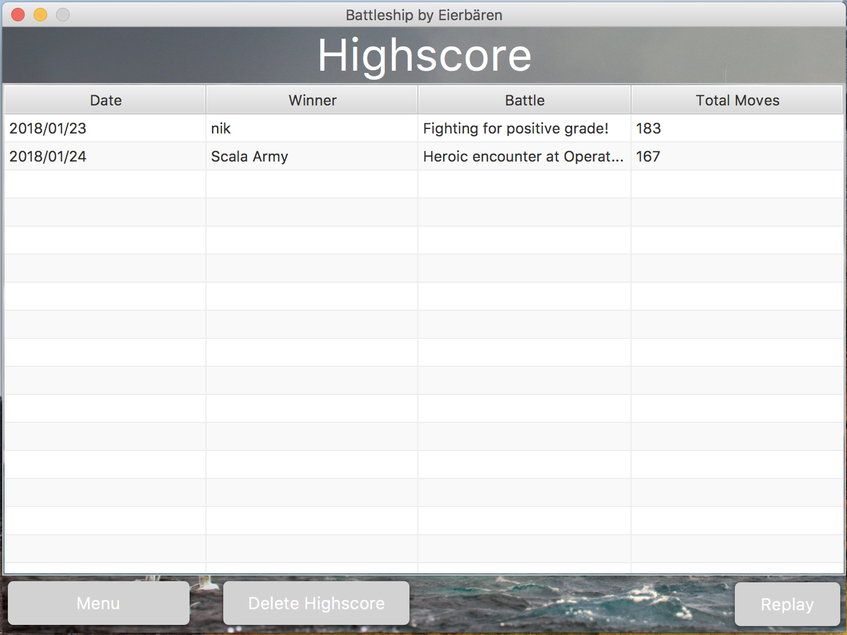

Slide 14
The Credit-Screen

Slide 15
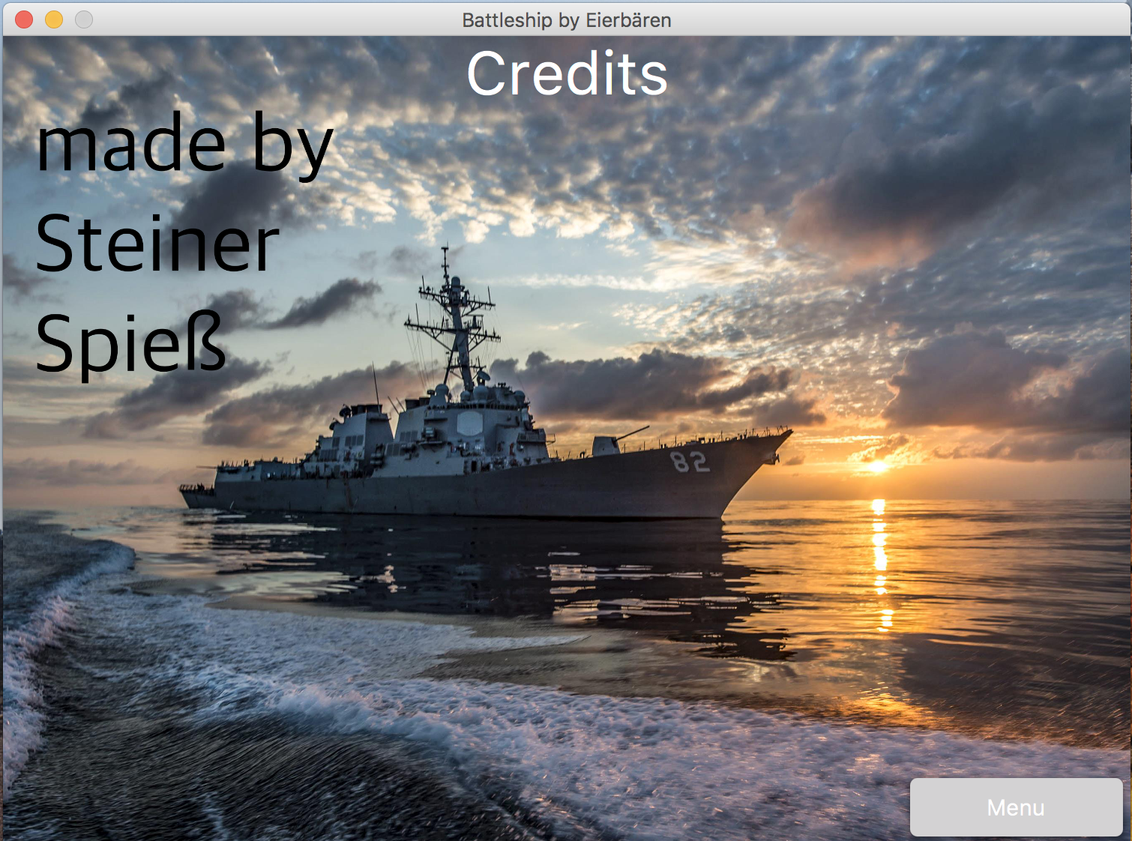

Slide 16
Join The Battle

